Slide 1
Building with HL7 FHIR
Vancouver, 2012 HL7 WGM
Grahame Grieve
Ewout Kramer
Lloyd McKenzie

Slide 2
Outline
Super-fast intro
Timelines
FHIR Development Artifacts
FHIR Development Process
Example
Development Guidelines & Considerations
Next Steps

Slide 3
Who are we?
Grahame Grieve
Australian, health interoperability – v2, v3, CDA, etc. tools, products, specifications, governance… http://www.healthintersections.com.au
Ewout Kramer
Chief architect & Manager R&D Furore
Dutch, architect in healthcare, messaging, data modeling, software development http://www.furore.com
Lloyd McKenzie
Canadian, data modeling, terminology, tooling, conformance
http://www.gordonpointinformatics.com

Slide 4
Caveats !
FHIR is a work in progress
Specification has been looked at by many people, but not subjected to ballot or any official review
FHIR continues to evolve
Much of what we tell you could change, at least somewhat, before it is stable

Slide 5
Quick Intro

Slide 6
30 second “Intro to FHIR”
As significant as leap from v2 to v3
Still leverage v3 infrastructure & knowledge
Pronounced “FIRE”
REST-enabled and based on resources but supports document, messaging & services paradigms too
All data is contained in a set of 100-150 resource definitions (for all of healthcare)
Resources contain the elements 80% of systems will actually use
Everything else is handled by extensions

Slide 7
More introduction to FHIR
If you want more, download the slides from the Q2 presentation:
http://gforge.hl7.org/svn/fhir/trunk/presentations/201205_WGM_Introduction_to_FHIR.pptx

Slide 8
Timelines

Slide 9
So when do we need to do this?
Plan is for Draft for Comment ballot of FHIR to go out in the September ballot
First DSTU ballot of FHIR, including initial set of resources targeted for January 2013 ballot cycle
Some resources more critical than others
Person, Patient, basic observations, etc.
TSC will help set priorities

Slide 10
Development Artifacts

Slide 11
SAIF Artifacts
4 artifact files used to maintain a Resource definition
[resourceName].xml
Excel XML file defining each element in the resource
[resourceName].htm
Supplemental file defining guidance on use of resource (notes, search criteria, etc.)
example.xml
Instance example of the resource
UML Diagram
EA (using svn) in package “[ResourceName]”, export to /images
All files in svn: http://gforge.hl7.org/svn/fhir/trunk/source/[resourceName]

Slide 12
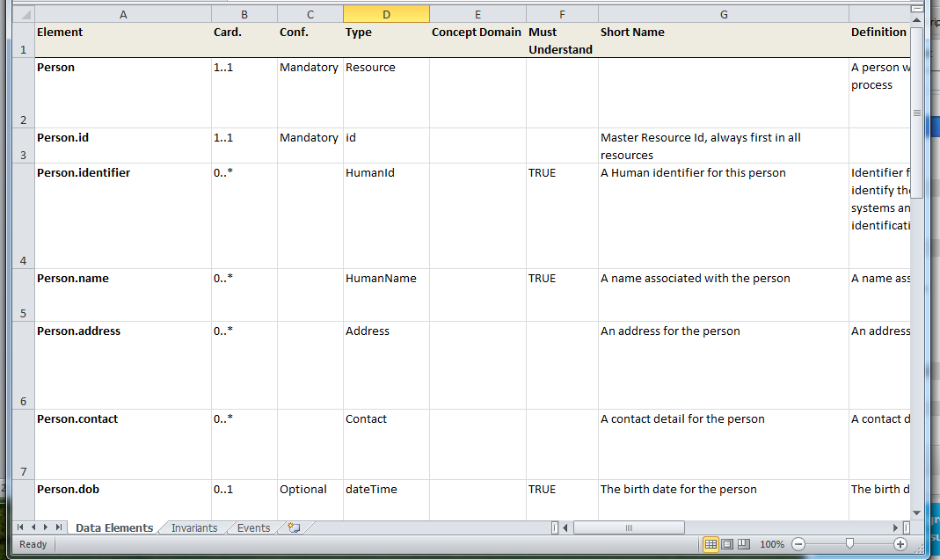
Master Definition: Spreadsheet
Stored as a Spreadsheet XML file (.xml)

Slide 13
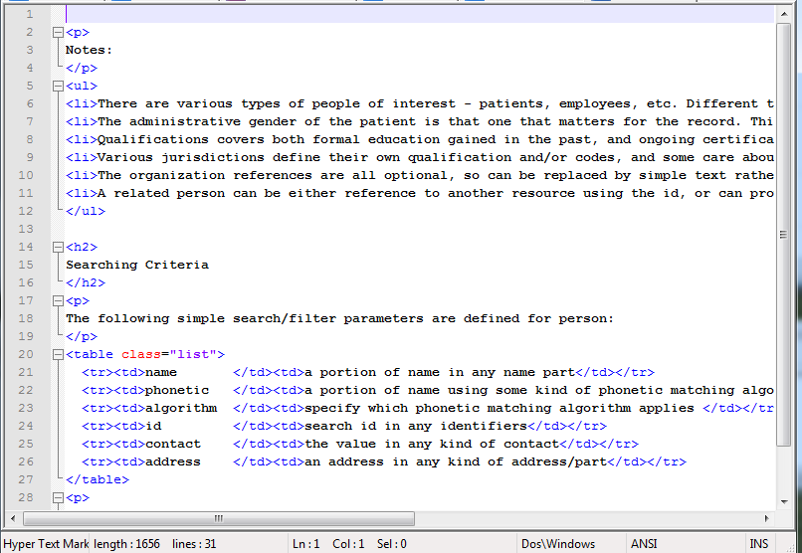
Additional Notes

Slide 14
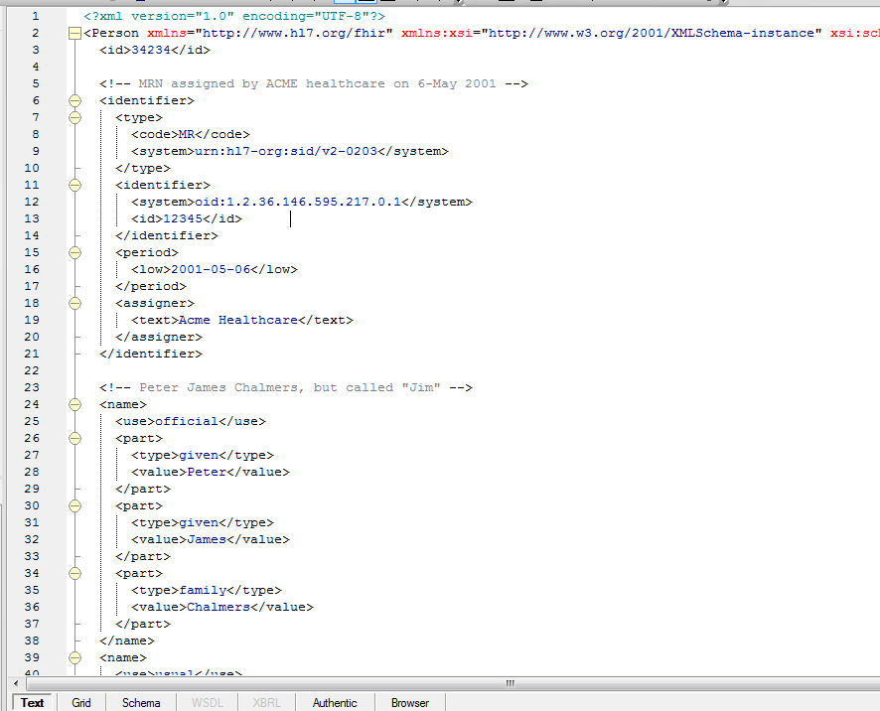
Example

Slide 15
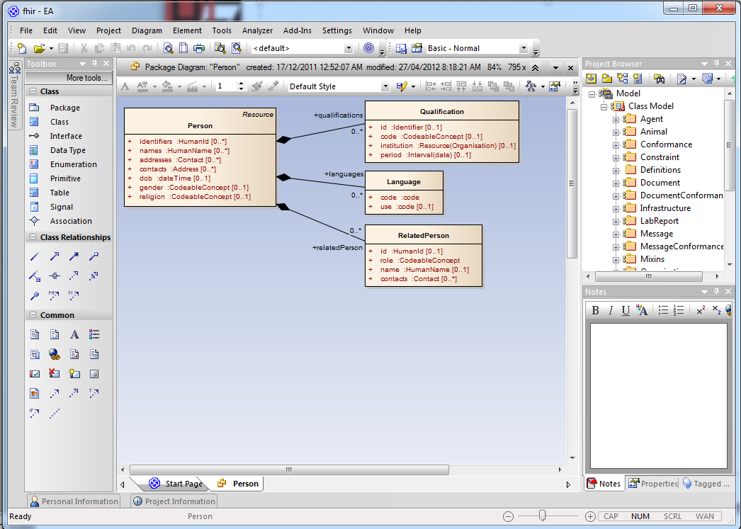
UML Diagram

Slide 16
Resource Definitions
The Canonical definition is the object model created by parsing the artifacts
The artifacts are a convenient low-tooling svn-friendly way to maintain the definitions
Other formats could be introduced. Rules:
Low $$ tooling requirements
Subversion friendly
Easy-ish to parse content in java code

Slide 17
Development Process

Slide 18
Process for creating resources
Define the “scope” for your proposed resource
Request a resource name
And permission to create that resource
Create and edit resource content
Publish resource
Iterate

Slide 19
Resource Scope
Scope should ideally be broad enough to meet the potential needs of a wide spectrum of users
inpatient + community, individual & public health, human & veterinary, all countries & realms
If not possible, the space needs to be segregated such that multiple non-overlapping resources can cover the space
Name needs to be linked to scope, and part of scope definition
Must pass a “reasonable person” test

Slide 20
Resource Scope
Relationship between proposed resource and other resources needs to be well described
Direction of links needs to be understood
In both directions – what will reference this?
What is the life cycle?
Does it have a status?

Slide 21
Requesting a Resource
Fill out request form & submit
Form yet to be developed
Requests Approved by Governance Committee
Likely to be chartered by TSC.
Membership based on contributions and commitment
Governance policies, processes TBD
Need transparency, good records, public debate
Looking for stability, reliability in resource maintenance

Slide 22
Creating a Resource
Once resource is created, governance committee will:
Create empty files
Create empty diagram
Register new resource with publication infrastructure
Check Resource is published ok
Add desired committee members to svn permissions

Slide 23
Build Process
Process:
Run publish.bat . (Needs Java runtime)
Checks & parses all source files
Runs internal validations to ensure coherence
Generates reference implementations
Generates schemas / JSON examples
Generates full specification
Validates examples against the schemas
Output:
Single directory, static htm/png/zip files
Host for web server (http://www.hl7.org/fhir)

Slide 24
Version Control
All FHIR definitions, source, etc. are subject to version control
Every committer can run the build process
Committers need to ensure the build process succeeds before committing
Much of the internal process enforcement for FHIR is delegated to social factors
i.e. a standard software development process

Slide 25
Creating and editing content
Recommended inputs:
v3 Domain models
CDA, Consolidated CDA story and other implementation guides (and IHE specifications)
v2 segments & national implementations
openEHR Archetypes (http://www.openher.org/ckm)
National repository definitions (possible sources: S&I (including the CEDD), UK NHS, Canada Health Infoway, Singapore LIMs, NEHTA (Australia)) - beware of local variations
Demonstration…

Slide 26
Example

Slide 27
Development Guidelines

Slide 28
What are the rules?
The “rules” are still in flux and will evolve based on initial development experience
The base rules reflect the premises on which FHIR is based
see Introduction to FHIR presentation
There are however a few that have been developed so far

Slide 29
How do we define scope?
Resources must not overlap
I.e. Given a clinical concept, there must be one (and only one) resource type that supports conveying that concept
Therefore, resource definitions must define clear boundaries between themselves and existing and expected resources
Should span all countries
Should span medical disciplines
Should usually even span human & veterinary

Slide 30
How do we decide 80-20?
First, look to your scope
Do 80% of all the existing systems covered by your scope use the element?
If your spec isn’t in use yet, would you expect 80% of all implementers within your scope to use the element?
Implementer = system responsible for maintaining that resource, not merely a system that references the resource
If unsure, err on the side of non-core rather than core (i.e. not in the 80%)
We can always move things based on DSTU

Slide 31
Element naming rules
Element names are lower camel case
U.S. English
Reflect domain-friendly terminology as internationally as possible
Are concise
Avoid abbreviations unless obvious to non-domain experts
Are consistent with other resources (where this doesn’t impact domain-friendliness)

Slide 32
Cardinality & optionality
Elements should only repeat if 80% of implementers will need repetitions
Elements should only be “mandatory” if the resource would be unusable without the data element present

Slide 33
Mappings
HL7 v3 mappings are mandatory
Syntax is still being finalized, but it will be x-path like
HL7 v2 mappings are mandatory if the resource has a corresponding construct in v2

Slide 34
Definitions
Definitions are mandatory
Must not be tautological
Should not be more than 1-2 sentences
Should describe what the element is, not what it is not
Should not include rationale or usage notes (other slots for these)
Should be accompanied by 3+ examples (Lloyd has a dream!)

Slide 35
More rules
Will be defined as we go along…

Slide 36
Next Steps

Slide 37
Individual “to do” list
Review the FHIR spec
http://www.hl7.org/fhir
Provide feedback
Contribute on wiki
http://wiki.hl7.org/index.php?title=FHIR

Slide 38
Work Group “to do” list
Draft a PSS for your committee to work on your resources
Submit resource requests for candidate resources
Form still in development
Start designing
Provide more feedback

Slide 39
FHIR this week
Several quarters scheduled for FHIR-related topics, including:
ITS: XML, JSON, REST - Wed Q1-Q2
RIMBAA: - Architecture of resources, example implementations Thurs Q1
Others TBA

Slide 40
Contacts
FHIR Mailing list: fhir@lists.hl7.org
Grahame: grahame@healthintersections.com.au
Ewout: e.kramer@furore.com
Lloyd: lloyd@lmckenzie.com

Slide 41
Questions & Answers

Slide 42
Q&A
The following slides were not part of the tutorial presentation, but summarize questions asked during or following the presentation.
Note: Some comments were applied directly as updates to slides rather than included in this section

Slide 43
Q&A
Is a resource definition a resource?
It could be. Will consider this
Why do we require ‘id’, ‘extensions’ and ‘text’ columns in the definition. Why not add them automatically during build?
Want to allow committees to provide contextual information if appropriate
What does “Must Understand” mean?
Can’t ignore the element without full understanding of the element and how it impacts other semantics.
Will provide better description

Slide 44
Licensing and Attribution
This presentation is copyright to HL7 International
It is licensed under the Creative Commons Attribution Non-commercial Share Alike 3.0 license
Details can be found here:
http://creativecommons.org/licenses/by-nc-sa/3.0/
The background image is sourced from quality3dmodels.net under the same license terms.

